Slide 1
COM4012M – Session Variables 2 (Shopping Carts)
Week 10 Lab Session 9

Slide 2
Session Variable Recap
Session variables are a lot like cookies. Though rather than being stored on your computer, they are stored on the web server so that they can be read from or written to by server scripts.
Each session file is unique to the user request that created it and can only be accessed by subsequent requests from the same user.
They essentially are a way to allow a computer to know who you are; even though a HTTP address doesn't maintain state.

Slide 3
Session Variable Purposes
Session variables are stored on a server and are less easily tampered with. They also require less scripting to encode and decode than a cookie string as you merely need to start the session and will work even if the user has cookies disabled.
Cookies best suited for small pieces of data that you can trust the user with (like font settings, site theme, etc.)
We use session variables for bigger data chunks (like storing objects, data structures, etc.) and ones you have to trust - like authorization status. This can include login systems – but also things like shopping carts.

Slide 4
Shopping Cart Breakdown
Step 1. A user should be able to choose the product they want to buy and the amount. They will likely do this using a HTML form.
Step 2. Once the user has chosen and input their products session variables will need to be made to store this information and product information will need to be requested from a database.
Step 3. A user will need to preview their shopping cart which calculates the total price of their order and allows them to buy their products.
Step 4. The user will want to purchase their products which will mean fulfilling the order and emptying the shopping cart.

Slide 5
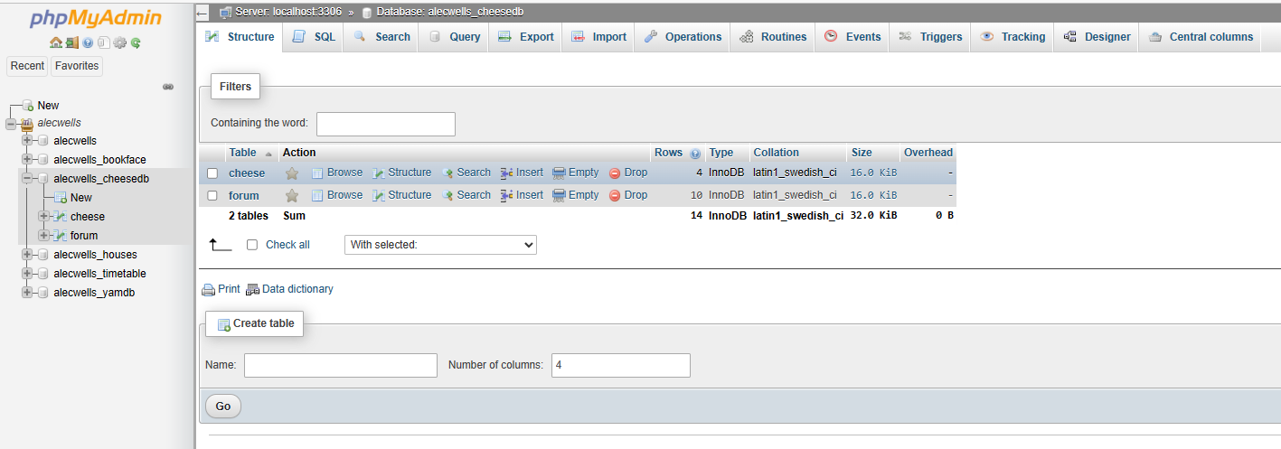
Shopping Cart Breakdown
The first thing we will need to build a functional shopping cart will be a database that stores all our products & their prices. Products will want to have some form of ID we can reference, name, pricing and potentially also stock numbers. We can do this using our phpMyAdmin:

Slide 6
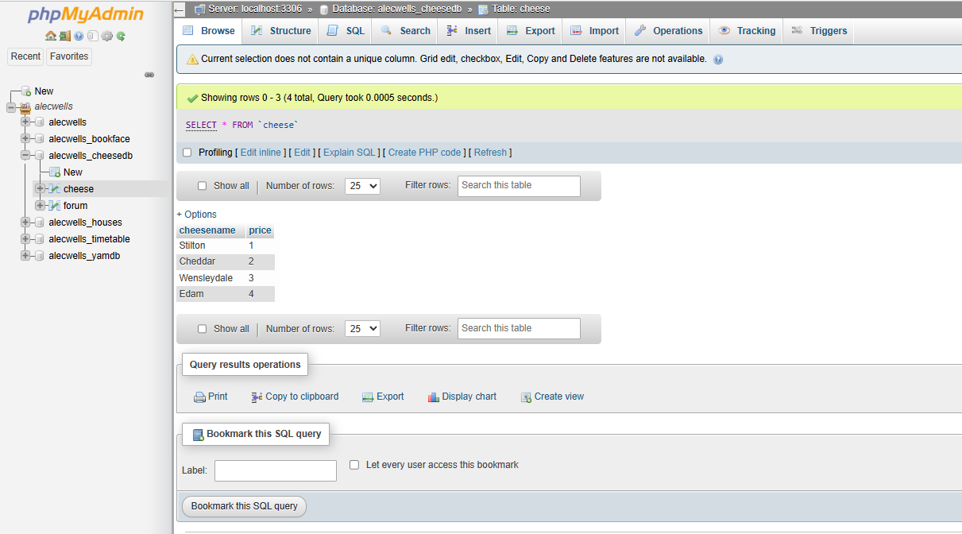
Shopping Cart Breakdown
Here is our table to store our products and prices, since this example is smaller the ID and stock numbers were left off:

Slide 7
Connection Shortcut
Then we will connect to our database like so:
<?php
$conn = mysqli_connect('localhost’, alec.wells , password, username_cheesedb)
if (mysqli_connect_errno())
{echo "Database Not Connected: " . mysqli_connect_error();}
?>
A shortcut to reduce the chance of types and make it so you don’t need to type out the connection string every time is to instead include a PHP file that contains the above connection code at the top of your pages instead, like so:
<?php
require ('connect.php’);
?>

Slide 8
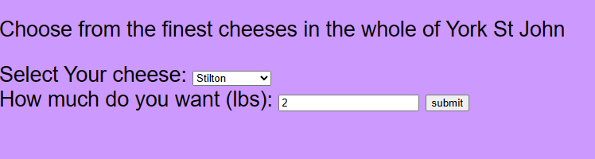
Shopping Cart Breakdown
Our website will have to display the variety of products we have, and we will then include a HTML form(s) for our products that allow a user to interact with them. The key data for this would be the ID of the product and the amount of product they want.

Slide 9
Form to Make Selection
<form class="Style2" id="cheeseform" action="cheese_cart2.php" method="post"> Select Your cheese: <select id="cheesetype" name="cheesetype">
<option value="stilton">Stilton</option>
<option value="cheddar">Cheddar</option>
<option value="wensleydale">Wensleydale</option>
<option value="edam">Edam</option>
</select>
<br />
How much do you want (lbs): <input type="text" name="amount" id="amount" />
<input type="submit" value="submit">
</form>

Slide 10
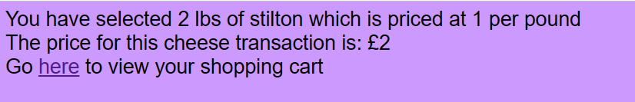
Shopping Cart Breakdown
When a user has selected the product, we can then display a breakdown of the transaction to them by retrieving the prices from our database:

Slide 11
Connect & Lookup Price
require ('connect.php’);
$cheesename = $_REQUEST['cheesetype’];
$cheeseamount = $_REQUEST['amount'];
$sql="SELECT * FROM Cheeses where cheesetype='$cheesename' "; if (mysqli_connect_errno())
{
echo "Failed to connect to MySQL: " . mysqli_connect_error();
}
$rs=mysqli_query($conn,$sql); if (!$rs)
{
die("Could not get data ".mysql_error());
}
if ($row=mysqli_fetch_array($rs)) { //if there is an output
$cheeseprice=$row['price’];
}

Slide 12
Cont. Calculate the Total Price & Save as Session Variables
echo "You have selected ". $cheeseamount." lbs of ".$cheesename." which is priced at ".$cheeseprice." per pound <br />";
$price=$cheeseamount*$cheeseprice;
/* $price=money_format('£%i', $price); */
echo "The price for this cheese transaction is: ".$price."<br />";
$_SESSION["cheeseamount"] = $cheeseamount;
$_SESSION["cheesename"] = $cheesename;
$_SESSION["cheeseprice"] = $cheeseprice;
$_SESSION["totalprice"] = 0;
$_SESSION["totalprice"] = $_SESSION["totalprice"]+$price;
echo "Go <a href='cheese_cart3.php'>here</a> to view your shopping cart ";

Slide 13
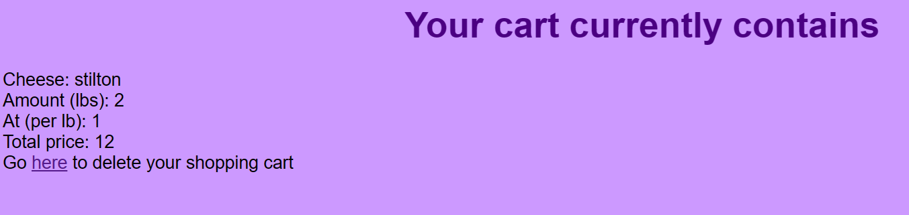
Shopping Cart Breakdown
We can then display the shopping card to the user by echoing all the session variables we created, as well as calculating the total price:

Slide 14
Display the Session Variables
<h1>Your cart currently contains</h1>
<?php
require ('connect.php’);
echo "Cheese: ".$_SESSION["cheesename"]."<br />"; echo "Amount (lbs): ".$_SESSION['cheeseamount']."<br
/>";
echo "At (per lb): £ ".$_SESSION["cheeseprice"]."<br />";
echo "Total price: £".$_SESSION["totalprice"]."<br />";
echo "Go <a href='cheese_cart4.php'>here</a> to delete your shopping cart ";
?>

Slide 15
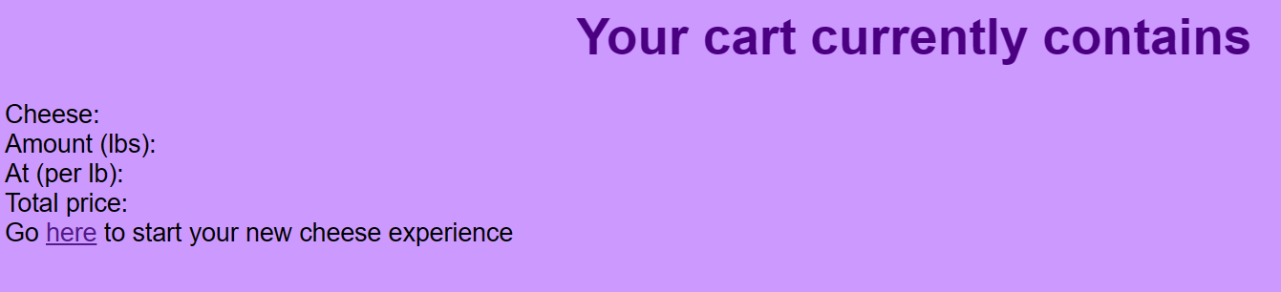
Shopping Cart Breakdown
When a user clicks the purchase button, they can then be redirected as the order is processed and the session is destroyed to empty the cart. At this point you could also subtract stock amounts from your databased based on the amount they ordered and in a real example this would also start the ordering processing – redirecting to their payment and storing their address credentials to fulfil the order.

Slide 16
Destroying the Session
<?php
session_destroy();
?>
<html>
<header></header>
<body>
<h1>Your cart currently contains</h1>
<?php
echo "Cheese: ".$_SESSION["cheesename"]."<br />";
echo "Amount (lbs): ".$_SESSION['cheeseamount']."<br />";
echo "At (per lb): ".$_SESSION["cheeseprice"]."<br />";
echo "Total price: ".$_SESSION["totalprice"]."<br />";
echo "Go <a href='cheese_cart1.html'>here</a> to start your new cheese experience ";
?>
</body>

Slide 17
Adding data to a Table HTML
You can add additional functionality such as adding data to a table like for example addresses like so:
<form method="post" action="php_add_record.php">
<p>Name: <input type="text" name="studentname" /></p>
<p>Course B.Sc.: <input type="checkbox“ name="coursename" /></p>
<p>Subject: <select name="subject">
<option value="Comp Sci">Computer Science
<option value="Design">Design
<option value="Arts">Arts
<option value="Business">Business
</select>
</p>
<input type="submit">
</form>

Slide 18
Adding data to a Table PHP
require ('connect.php’);
$studentname = $_REQUEST["studentname"]; //get the data from the form
if (isset($_REQUEST['coursename'])) { $coursename="B.Sc.";
}
else { $coursename="Not Degree"; // set the data for the coursename field
}
$subject = $_REQUEST['subject’];
$sql="INSERT INTO Students (studentname, subject,course) VALUES
('$studentname','$subject','$coursename')";
if (mysqli_connect_errno())
{
echo "Failed to connect to MySQL: " . mysqli_connect_error();
}
if (mysqli_query($conn,$sql)) {
echo "Record added";
}
mysqli_close($conn); //close connection to database

Slide 19
Updating a Table HTML
You can add additional functionality such as updating the table to subtract the order from the total stock of the item like so:
<html>
<body>
<form method="post"
action="php_update.php">
<p>Name: <input type="text"
name="studentname" />
<p>Address: <input type="text"
name=“address" />
<input type="submit">
</form>
</body>
</html>

Slide 20
Updating a Table PHP
<?php
$studentname = $_REQUEST ['studentname’];
$address = $_REQUEST [‘address ‘];
echo "$studentname";
echo "$address";
require ('connect.php’);
$sql="UPDATE Students SET address ='$ address ' WHERE studentname='$studentname’”;
echo $sql;
if (mysqli_query($conn,$sql)) {
echo "Record updated";
}
else {
echo "There was an error";
}
mysqli_close($conn);

Slide 21
Sourced
www.w3schools.com

